Slide 1
Commuter Aided Design CAD
Lecture 3

Slide 2
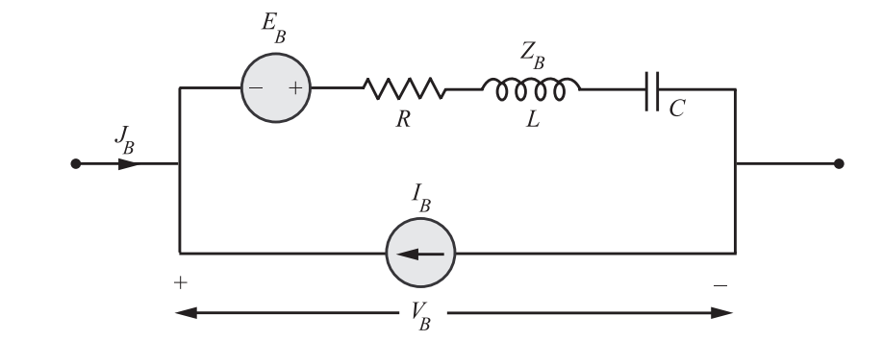
Network Equilibrium Equations
Loop equations: A branch of a network can, in general, be represented as shown in Figure
where E_{B} is the voltage source of the branch.
I_{B} is the current source of the branch
Z_{B} is the impedance of the branch
J_{B} is the current in the branch

Slide 3
Network Equilibrium Equations
The voltage-current relation is then given by
V_{B} =(J_{B} + I_{B} ) Z_{B} − E_{B}
For a general network with many branches, the matrix equation is
V_{B} = Z_{B} (J_{B} +I_{B} ) − E_{B} (1)
Where V_{B} , J_{B} , I_{B} , and E_{B} are B × 1 vectors and Z_{B} is the branch impedance matrix of B × B

Slide 4
Network Equilibrium Equations
Each row of the tie-set matrix corresponds to a loop and involves all the branches of the loop. As per KV L, the sum of the corresponding branch voltages may be equated to zero. That is
BV_{B} =0 (2)
where B is the tie-set matrix.
In the same matrix, each column represents a branch current in terms of loop currents. Trans- posed M is used to give the relation between branch currents and loop currents.
J_{B} = B^{T}I_{L} (3)
This equation is called loop transformation equation.

Slide 5
Network Equilibrium Equations
Substituting equation (1) in (2),
V_{B} = Z_{B} (J_{B} +I_{B} ) − E_{B} (1)
BV_{B} =0 (2)
we get
BZ_{B} {J_{B} + I_{B} }−BE_{B} = 0 (4)
J_{B} = B^{T}I_{L} (3)
Substituting equation (3) in (4)
we get
BZ_{B} B^{T}I_{L} + BZ_{B} I_{B} − BE_{B} = 0
BZ_{B} B^{T}I_{L} = BE_{B} − BZ_{B} I_{B}

Slide 6
Network Equilibrium Equations
Get V_{B} branch voltage and J_{B} branch current using cut-set matrix
Each row of the cut-set matrix corresponds to a particular node pair
voltage and indicates different branches connected to a particular node. KCL can be applied to the node and the algebraic sum of the branch currents at that node is zero.
CJ_{B} =0 (5)
Each column of cut-set matrix relates a branch voltage to node pair voltages. Hence,
V_{B} = C^{T}E_{N} (6)

Slide 7
Network Equilibrium Equations
Current voltage relation for a branch is.
J_{B} = Y_{B} (V_{B} +E_{B} ) −I_{B}
For a netwrok with many branches the above equation may be written in matrix form as,
J_{B} = Y_{B} V_{B} + Y_{B} E_{B} − I_{B} (7)
where Y_{B} is branch admittance matrix of B × B.

Slide 8
Network Equilibrium Equations
Substituting equation (7) in (5)
CJ_{B} =0 (5)
J_{B} = Y_{B} V_{B} + Y_{B} E_{B} − I_{B} (7)
We get
CY_{B} V_{B} + CY_{B} E_{B} − CI_{B} =0 (8)
Substituting equation (6) in (8)
V_{B} = C^{T}E_{N} (6)
We get
CY_{B} C^{T}E_{N} = C (I_{B} − Y_{B} E_{B} )

Slide 9
Network Equilibrium Equations
Substituting equation (7) in (5)
CJ_{B} =0 (5)
J_{B} = Y_{B} V_{B} + Y_{B} E_{B} − I_{B} (7)
We get
CY_{B} V_{B} + CY_{B} E_{B} − CI_{B} =0 (8)
Substituting equation (6) in (8)
V_{B} = C^{T}E_{N} (6)
We get
CY_{B} C^{T}E_{N} = C (I_{B} − Y_{B} E_{B} )

Slide 10
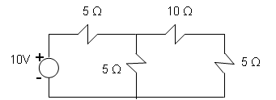
Example
For the network shown in Figure write a tie-set matrix and then ﬁnd all the branch currents and voltages.

